Slide 1
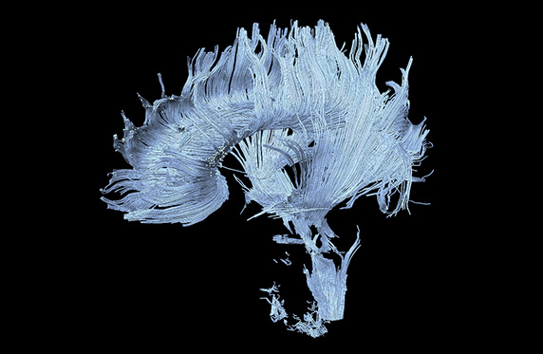
Diffusion Tensor Imaging: Concepts & Applications
Aaron Fisher
May 7, 2013

Slide 2
What is Diffusion Tensor Imaging (DTI)?
Uses bipolar magnetic field gradient pulses to measures molecular diffusion within a voxel.
Only diffusion in the direction of the gradient are detectable, requiring us use gradients in several directions.
In myelinated axonal fibers, diffusion has been shown to be faster along the direction of the fibers than in the direction perpendicular to them.
DTI images can be used to estimate orientation of fiber tracks, and fiber track integrity.
Notes:
Anisotropic diffusion refers to directed diffusion.

Slide 3
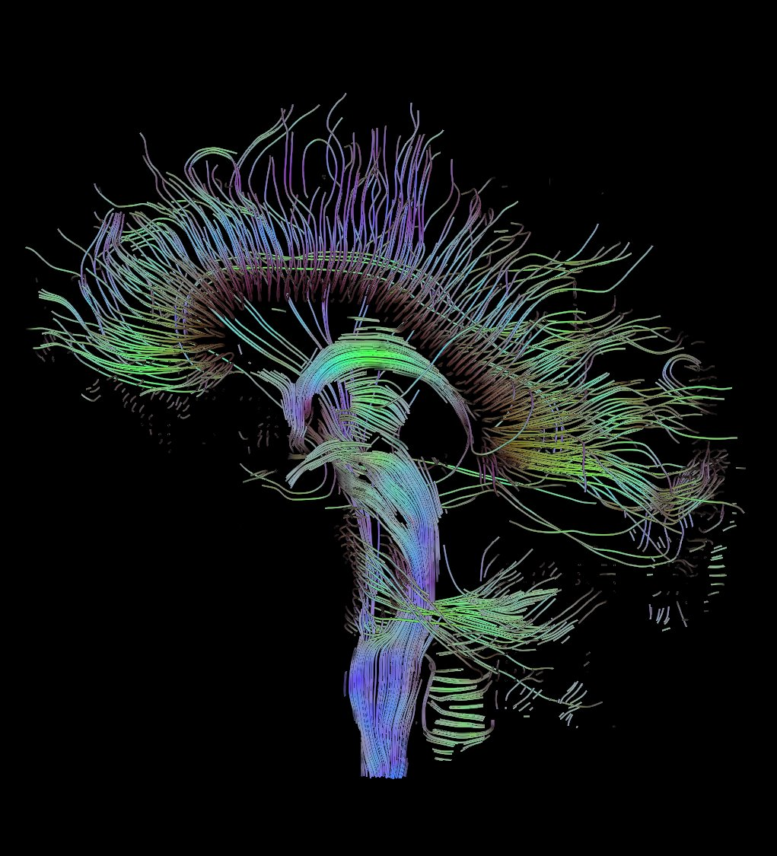
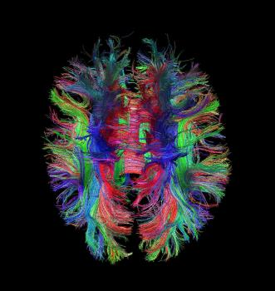
Who’s the fairest modality of them all?
Link1, link2
Notes:
Color usually corresponds with directedness of diffusion (anisotropy defined on next slide)

Slide 4
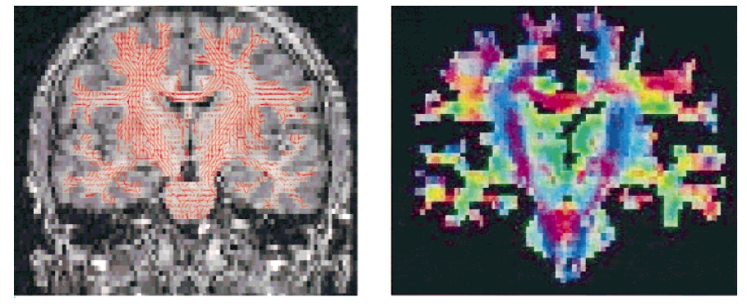
Two ways to plot DTI
Notes:
Sometimes RGB color is used to represent directionality (x = red, y = green, z = blue, relative to us)
Interesting side note – “MR color mapping of myelin fiber orientation” article literally printed in B & W.

Slide 5
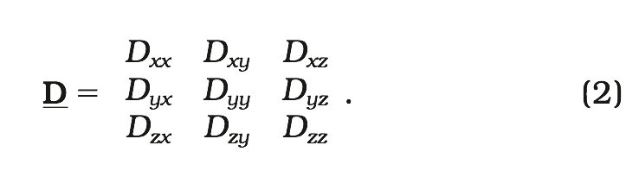
Diffusion tensor – data acquisition
Isotropic (“plain”) diffusion: Diffusion can be fully described by a coefficient D. This can be determined, using the equation:
A = exp(-bD)
where A represents spin echo signal attenuation, and b characterizes the gradient pulses used.
Anisotropic diffusion: Diffusion is characterized now by mobility in the x, y and z, dimensions, along with their correlations. We represent all of these directions with the tensor D.
Notes:
This tensor parameterization is what allows us to study anisotropy, it was an innovation. Before this there was diffusion MRI, but now we can also study anisotropy. Here we have 6 directions (symmetric 3x3), but there’s work in doing hundreds of directions.

Slide 6
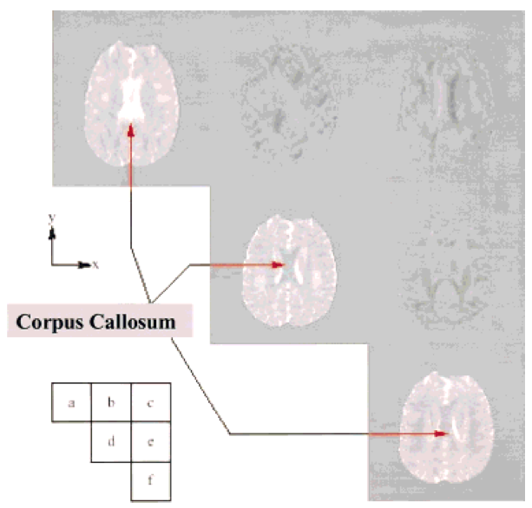
3D Tensor
Notes:
It’s x, y, z going down the diagonal of the tensor. (x = horizontal, y = vertical wrt you).

Slide 7
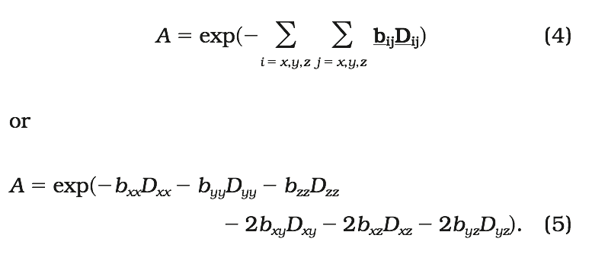
Diffusion tensor – data acquisition
Aquiring D in anisotropic case: b is also replaced by a 3 x 3 matrix b, and signal attenuation is now:
D can be estimated using a regression based on the above equation.
Notes:
Note, if D is know to be diagonal, the above form simplifies. However, if we think D is non-diagonal, but all we want to estimate is the diagonal, we still need to include all these terms in our regression.

Slide 8
Nondiagonal Diffusion Tensors – 2D illustrations
Notes:
All have same “magnitude”. **Show with fingers**

Slide 9
Finding a reference frame
Among other things, we want to know the primary directions of diffusivity, and the amount of diffusivity in each of these directions.
A reference frame of orthogonal vectors [x’,y’,z’] is the basis in which D can be represented as a diagonal matrix.
These reference vectors x’, y’ and z’ will also correspond to the primary directions of diffusivity.
This can be solved with by taking the singular value decomposition (SVD) of D.

Slide 10
Singular value decomposition of the diffusion tensor (in 3D)
Let UΛU’ be the singular value decomposition (SVD) of D, where U is a 3x3 matrix, and Λ is a 3x3 diagonal matrix with diagonal elements denoted by λ₁, λ₂, and λ₃.
UΛU’= D
The three columns of U form an orthonormal basis corresponding to the primary directions of diffusion.
λ₁, λ₂, and λ₃ represent the diffusion in each of these directions.

Slide 11
Finding a reference frame – 2D Illustration
Notes:
These both have the same mean diffusivity (from Tr(D)), and also the same magnitude from diag Λ

Slide 12
DTI Metrics
Primary direction of diffusivity
Attainable from SVD(D)
Mean diffusivity: characterizes the overall mean-squared displacement of molecules.
Independent of primary direction of diffusivity.
Degree of anisotropy: the directedness of diffusion.
All of these are measuring actual biological things. The unit’s aren’t just relative, they’re meaningful.
Notes:
Diffusion coefficients obtained at different times in a given patient or in different patients or in different hospitals can be compared, in principle, without any need for normalization.

Slide 13
Mean Diffusivity
We want this quantity to be invariant to the orientation of the reference frame [x’,y’,z’], or U in our notation here.
Mean Diffusivity := Trace(D)/3
Where Trace(D) = D[x,x] + D[y,y] + D[z,z]
Note, this is equal to (λ₁+λ₂+λ₃)/3, but this doesn’t matter.
Notes:
We don’t have to actually know the reference frame. For any UVU’=D, tr(UVU’)=tr(D), of course. You could view the fact that these D’s have mean diffusivity *as a result* of the fact that they have the same eigenvalues.

Slide 14
Diffusion Anisotropy Indices
Relative Anisotropy (RA): standardized squared deviations. (Range: 0-√2, √2 is anisotropic).
Fractional Anisotropy (FA): Magnitude of diffusion tensor explained by anisotropic diffusion. (Range: 0-1, 1 is anisotropic).
Volume Ratio (VR): Ratio of volume of the ellipse to the volume of the sphere with radius mean(λ). (Range: 0-1, but 1 is isotropic).
Notes:
Magnitude of D is like the norm, or distance of the vector (λ1, λ2, λ3).

Slide 15
Visualizing Fractional Anisotropy

Slide 16
Complications – Apparent Diffusion Coefficient (ADC)
Voxels contain both intracellular and extracellular compartments. Low (b values?) gradients used are more sensitive to to fast diffusion compartments, (possibly?) corresponding more to the extracellular diffusion.
Changes in ADC should be interpreted in terms of diffusion changes in the extracellular space, and in terms of changes in the relative volume of extracellular v. intracellular space.
This volume ratio relevant to detection of brain ischemia and other problems.

Slide 17
Interpreting ADC
Generally it’s been shown that anisotropy is high in myelinated white matter, and even before fibers become myelinated.
This was once explained by myelin sheaths restricting the flow of intracellular water.
It’s now thought that since studies with low b-values are more sensitive to extracellular diffusion, this anisotropy is actually mostly due to the structures that impede the flow of extracellular molecules.
In a compact bundle of parallel fibers, movement perpendicular to fibers is more impeded than parallel movement.

Slide 18
Applications
In general, mean diffusivity characterizes overall water content and anisotropy indices reflect myelin fiber integrity.
Brain Ischemia – restriction in blood supply that corresponds with a drop in water diffusion, possibly due to shrinkage of the extracellular space.
DTI useful for detection, as the diffusion change precedes cell damage detectable on conventional MRI.
Notes:
Ischemia – restriction of blood supply to the tissue.
Ischemia was one of the early applications in the early 90s, from research on cat brains.

Slide 19
Applications – Diseases
DTI shown useful in studying:
Brain maturation in children
multiple sclerosis
Leukoencephalopathy
Wallerian degeneration
Alzheimer's disease
Schizophrenia
Dyslexia
Brain Tumors
AIDS
Trauma
hypertensive hydrocephalus
Leukoaraiosis
Cerebral Auto- somal Dominant Arteriopathy with Subcortical Infarcts and Leucoenuphalopathy (CADASIL)
Migraine
Spinal cord studies
AIDS
Eclampsia

Slide 20
Thanks very much!
Paper:
Le Bihan, D., Mangin, J. F., Poupon, C., Clark, C. A., Pappata, S., Molko, N., & Chabriat, H. (2001). Diffusion tensor imaging: concepts and applications. Journal of magnetic resonance imaging, 13(4), 534-546. link

